Slide 1

Lecture #0
SOFT COMPUTING
INT508

Slide 2
Course Overview
CSE510, Lovely Professional University, Phagwara
Text Books: 1.
Soft Computing With Matlab By N.P. Padhy, Oxford University Press
References:
1. PRINCIPLES OF SOFT COMPUTING By S. N. Sivanandam, S.N. Deepa, Wiley
2. NEURO-FUZZY AND SOFT COMPUTING: A COMPUTATIONAL APPROACH TO LEARNING AND MACHINE INTELLIGENCE By JANG, SUN & MIZUTANI, PRENTICE HALL

Slide 3
CSE510, Lovely Professional University, Phagwara
Unit I
Introduction : Artificial intelligence, Artificial neural networks, Genetic algorithm, Swarm intelligent
systems, Expert systems
Neural Network Concepts : Introduction to neural networks, biological neural networks to artificial
neural networks, Classification of ANNs, McCulloch-Pitts neuron model, learning rules-Hebbian, Delta,
Perceptron network
Unit II
Neural Networks : Backpropagation neural networks, Kohonen neural network, Learning vector
quantization, Adaptive resonance theory neural networks, Radial basis function neural networks,
Support vector machines

Slide 4
CSE510, Lovely Professional University, Phagwara
Unit III
Fuzzy Systems : Basic definition and terminology, set-theoretic operations, Fuzzy Sets, Operations
on Fuzzy Sets, Fuzzy Relations, Fuzzy Rules and Fuzzy Reasoning, Fuzzy Inference system, Fuzzy
Expert Syatems
Unit IV
Genetic Algorithms : Introduction to Genetic algorithms(GA), Representation, Genetic algorithm
operators-Methods of selection, crossover and mutation, Working of GA, Application of GA

Slide 5
CSE510, Lovely Professional University, Phagwara
Unit V
Hybrid Systems : Hybrid systems, Genetic algorithm based Backpropagation network, Fuzzy
Backpropagation network, Neuro-fuzzy systems, Fuzzy genetic algorithms
Unit VI
Swarm Intelligence : swarm intelligence, Cuckoo search, flocks of birds, ant colony optimization,
swarm intelligence in bees, shoals of fish

Slide 6
CSE510, Lovely Professional University, Phagwara
Course Outcomes:
CO1 :: describe soft computing techniques and their roles in building intelligent machines.
CO2 :: explain different neural networks for classification and clustering problems.
CO3 :: use fuzzy logic and reasoning to handle uncertainty and solve engineering problems
CO4 :: compare genetic algorithms and swarm intelligence for optimization problems.
CO5 :: evaluate the performance and time complexity of hybrid systems.
CO6 :: develop the optimal solutions using available soft computing tools to solve real world
problems.

Slide 7
Introduction
Soft Computing refers to a consortium of computational methodologies like fuzzy logic, neural networks, genetic algorithms etc
All having their roots in the Artificial Intelligence
Artificial Intelligence is an area of computer science concerned with designing intelligent computer systems.
Systems that exhibit the characteristics we associate with intelligence in human behavior.

Slide 8
Soft Computing was introduced by Lotfi A zadeh of the university of California, Berkley, U.S.A
The soft computing differs from hard computing in its tolerance to imprecision, uncertainty and partial truth.
Soft Computing is the fusion of methodologies designed to model and enable solutions to real world problems, which are not modeled or too difficult to model mathematically.
The aim of Soft Computing is to exploit the tolerance for imprecision, uncertainty, approximate reasoning, and partial truth in order to achieve close resemblance with human like decision making.

Slide 9
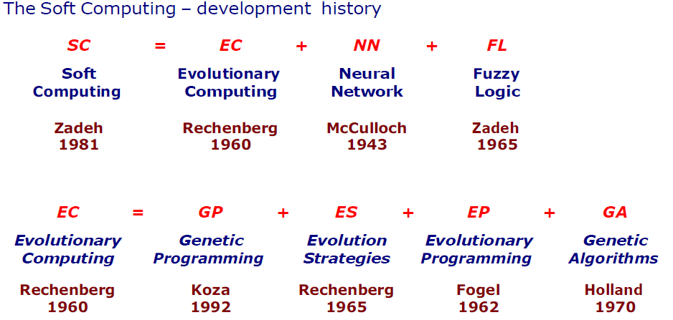

Slide 10
The Soft Computing consists of several computing paradigms mainly :
Fuzzy Systems, Neural Networks, and Genetic Algorithms.
Fuzzy set : for knowledge representation via fuzzy If – Then rules.
Neural Networks : for learning and adaptation
Genetic Algorithms : for evolutionary computation

Slide 11
The Soft Computing consists of several computing paradigms mainly :
Fuzzy Systems, Neural Networks, and Genetic Algorithms.
Fuzzy set : for knowledge representation via fuzzy If – Then rules.
Neural Networks : for learning and adaptation
Genetic Algorithms : for evolutionary computation

Slide 12
Its aim is to exploit the tolerance for Approximation, Uncertainty, Imprecision, and Partial Truth in order to achieve close resemblance with human like decision making.
Approximation : here the model features are similar to the real ones, but not the same.
Uncertainty : here we are not sure that the features of the model are the same as that of the entity (belief).
Imprecision : here the model features (quantities) are not the same as that of the real ones, but close to them.

Slide 13
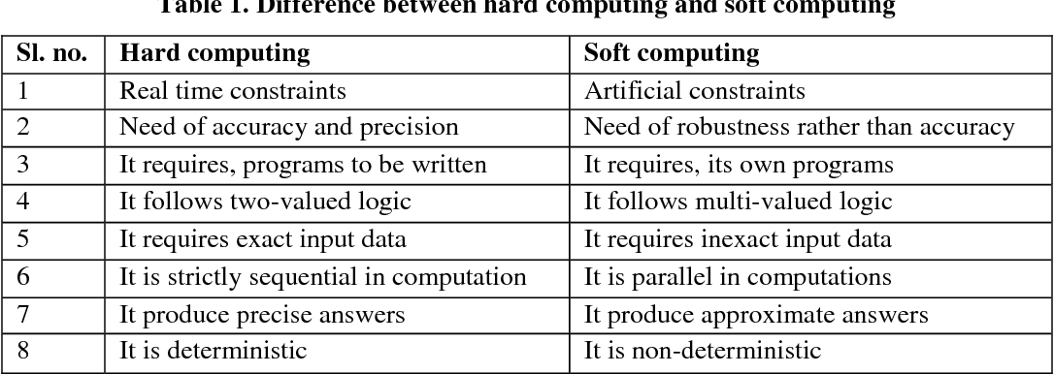

Slide 14
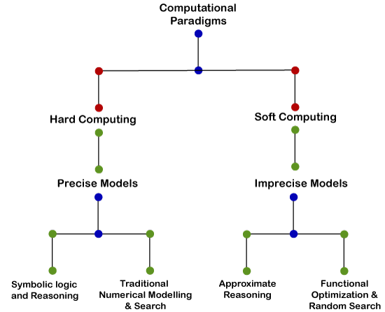

Slide 15
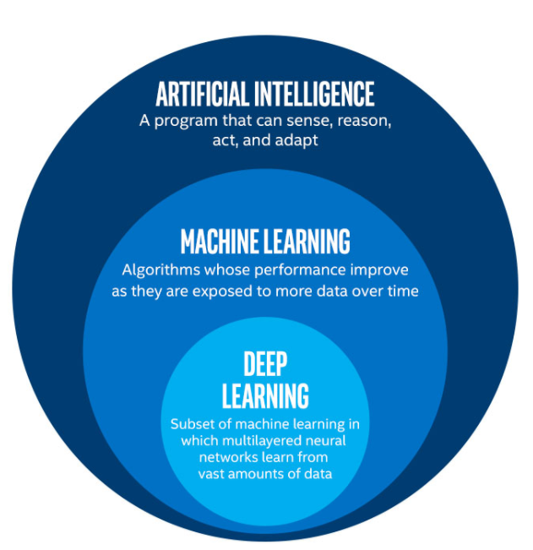

Slide 16
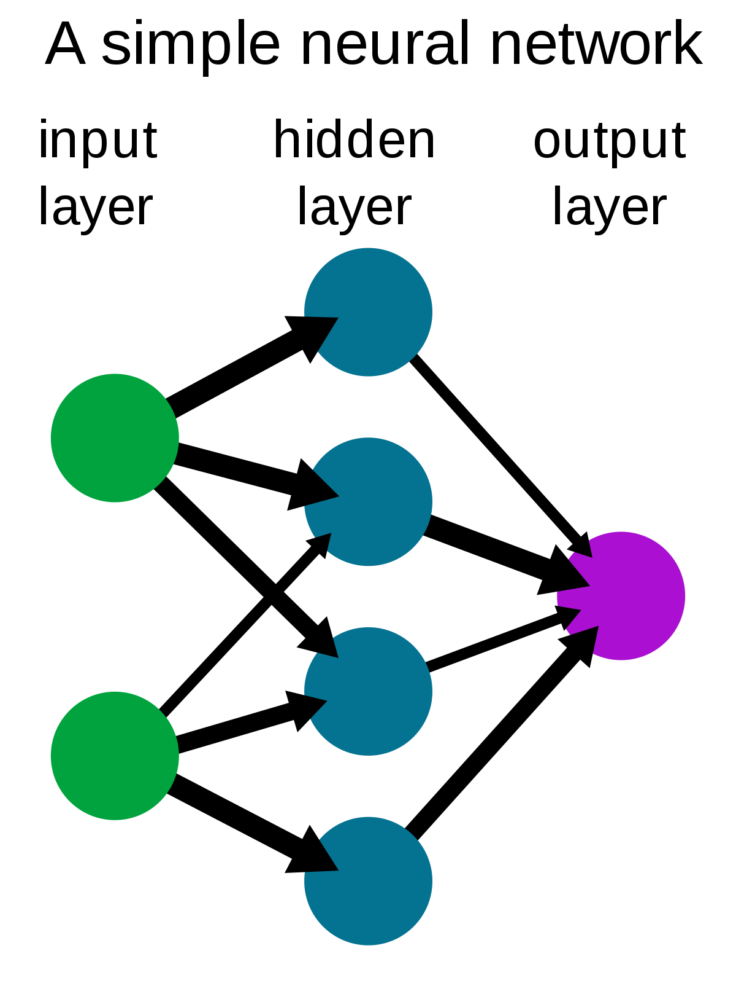

Slide 17
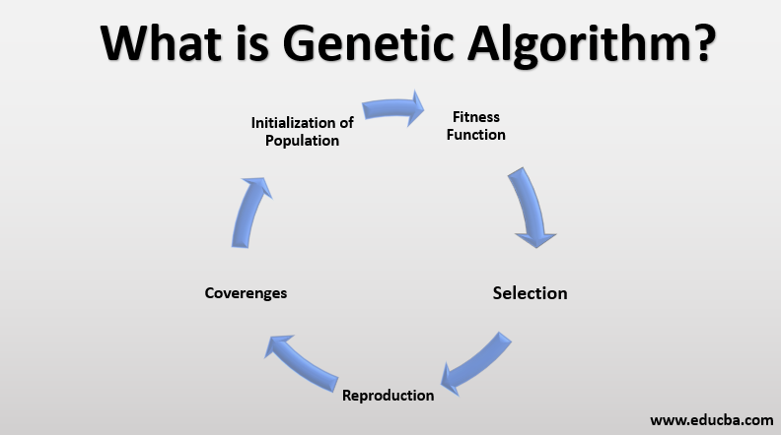

Slide 18
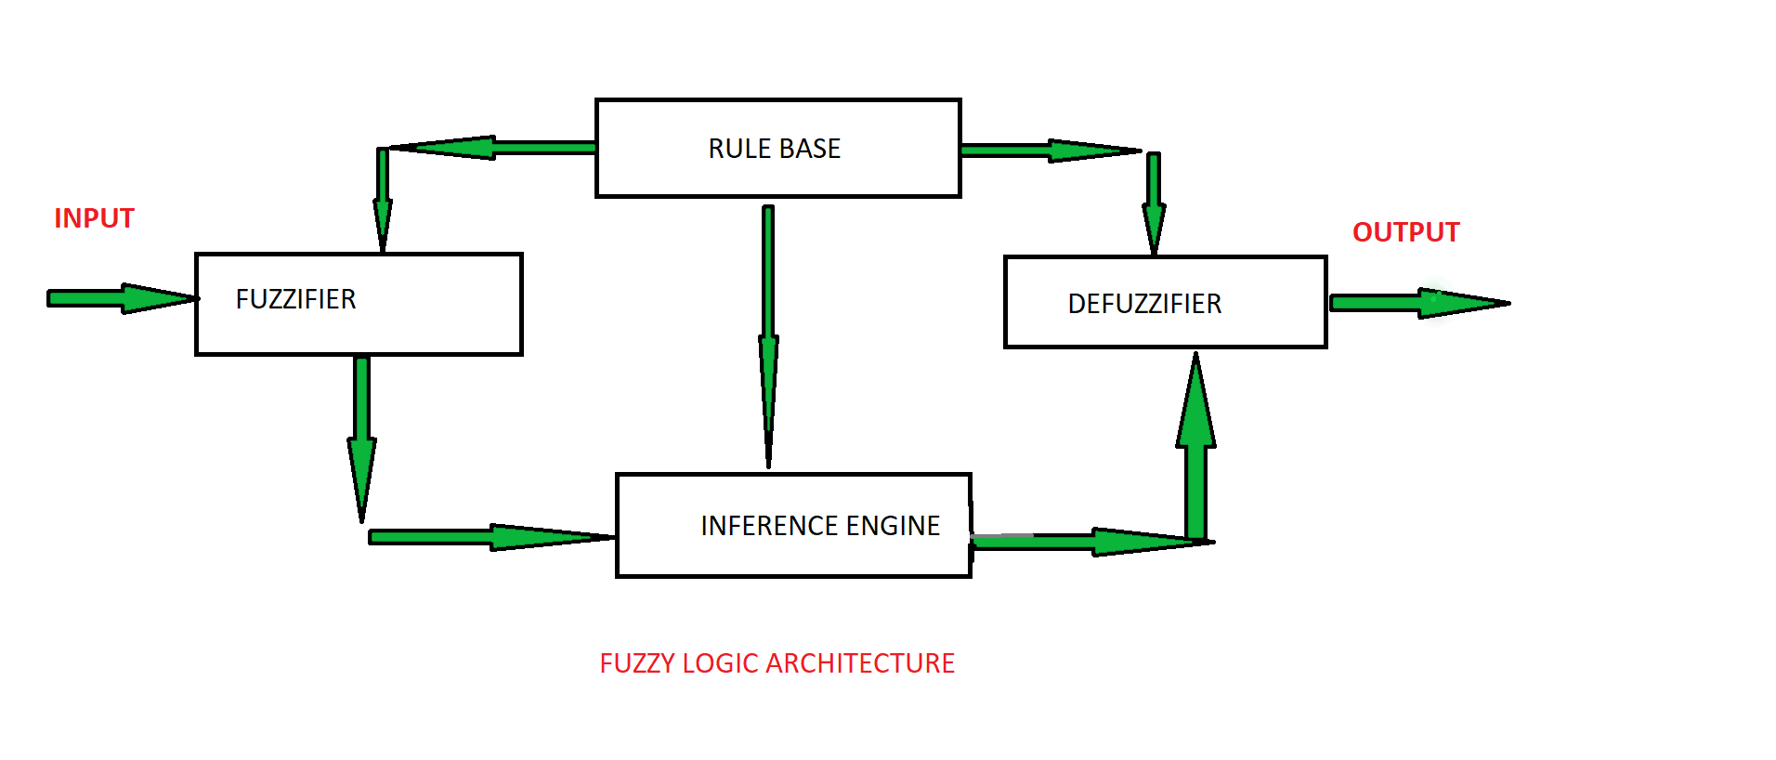

Slide 19
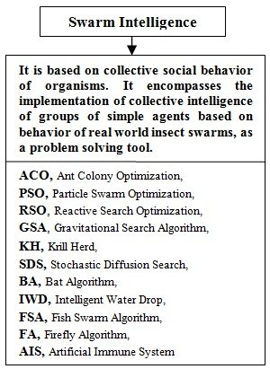

Slide 20
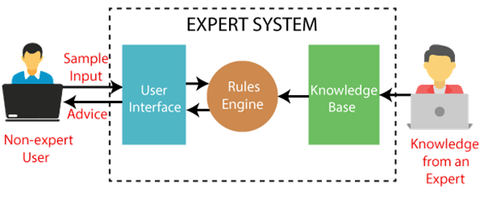

Slide 21

12/12/14
CSE510, Lovely Professional University, Phagwara

